Slide 1
MUSIC
‘Sabbah’

Slide 2
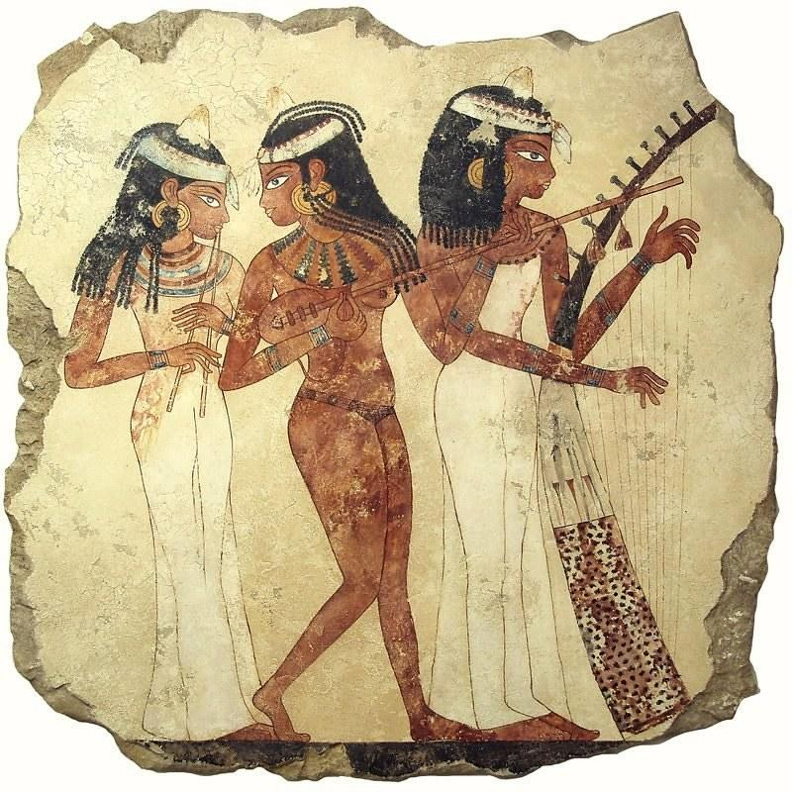
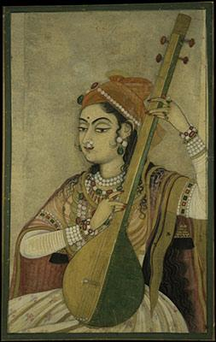
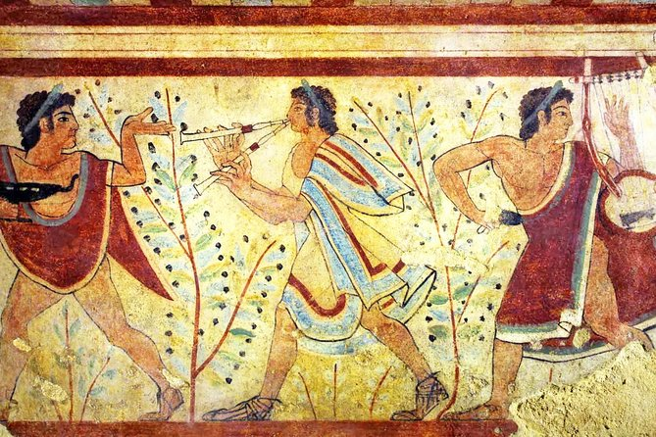
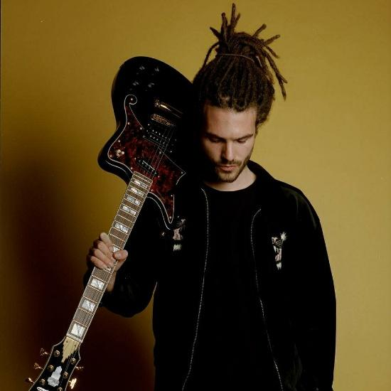
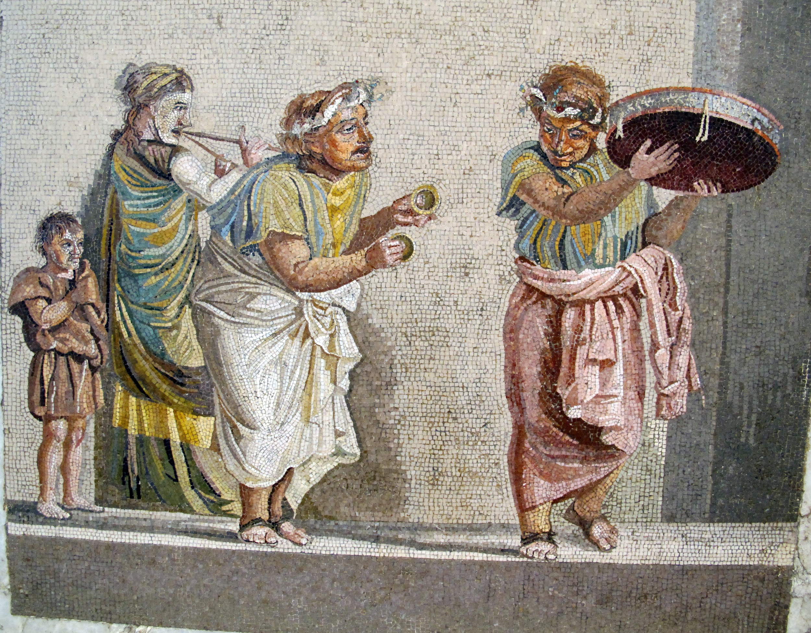

Slide 3
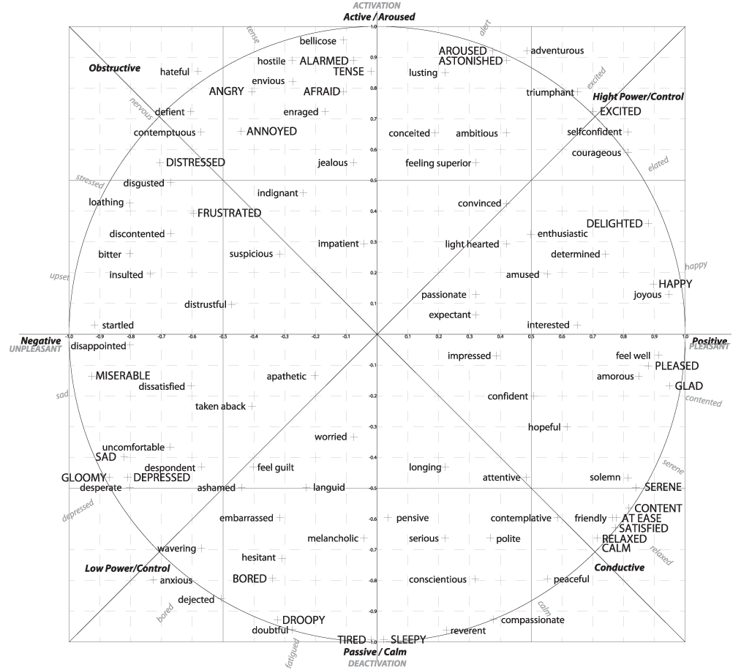
Arousal
(energy)
Valence
(positivity)

Slide 4
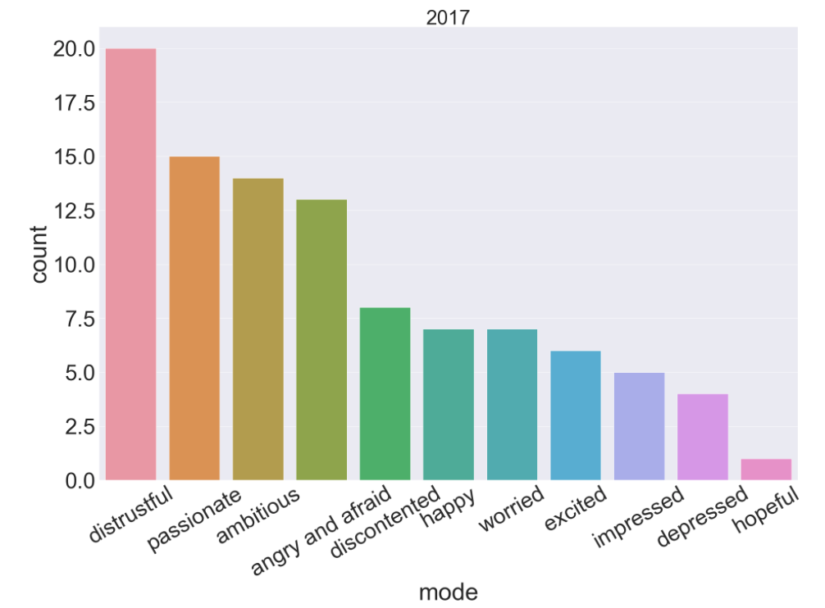
2017
distrustful::::Bad Things ‘Machine Gun Kelly’
Passionate:::
Closer ‘The Chainsmokers’
Ambitious::
Believer ‘Imagine Dragons’

Slide 5
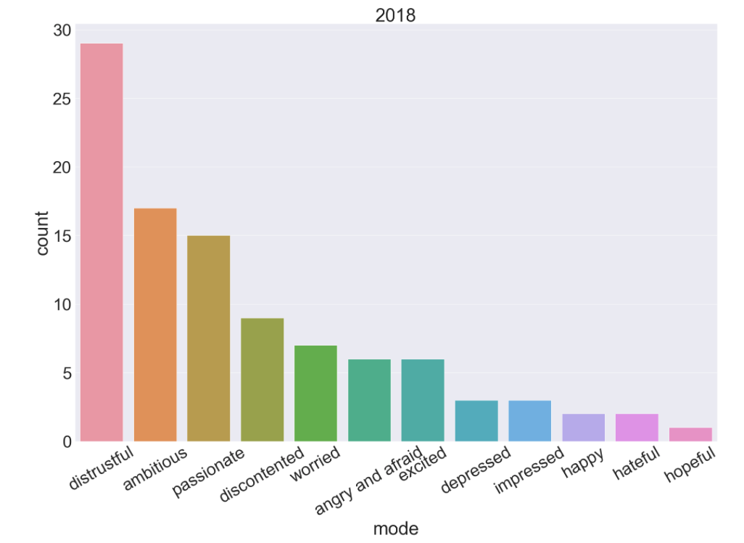
2018
distrustful::::
SAD! ‘XXXTENTACION’
ambitious::::
FRIENDS ‘Marshmello’
passionate::::
Moonlight ‘XXXTENTACION’

Slide 6
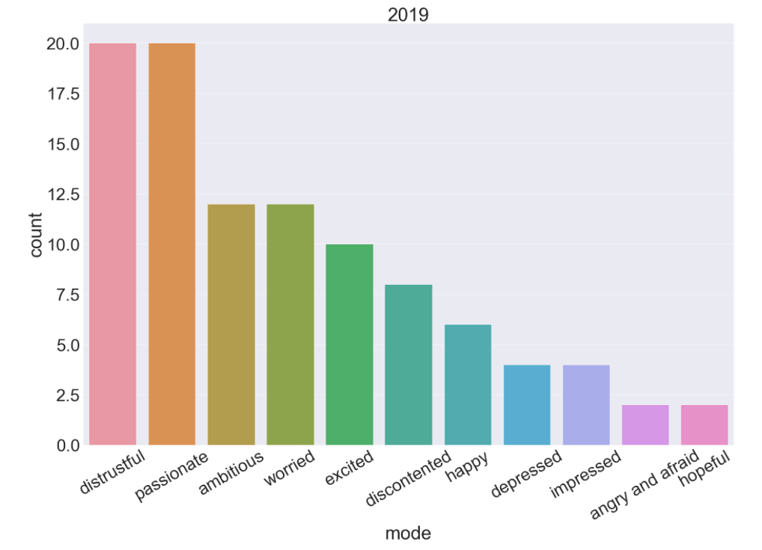
2019
distrustful::::
How Do You Sleep? ‘Sam Smith’
passionate::::
Dance Monkey ‘Tones and I’
ambitious::::
Con Calma ‘Daddy Yankee’

Slide 7
{::Differences::}

Slide 8
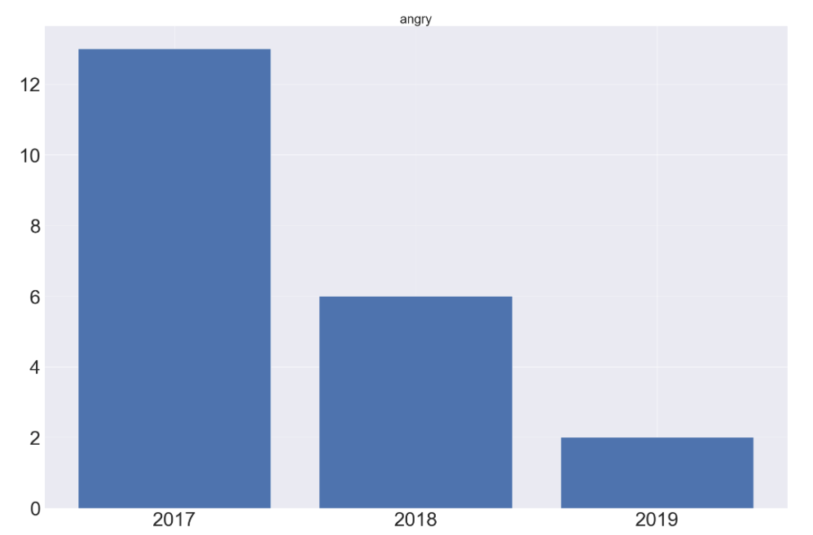
ANGER

Slide 9
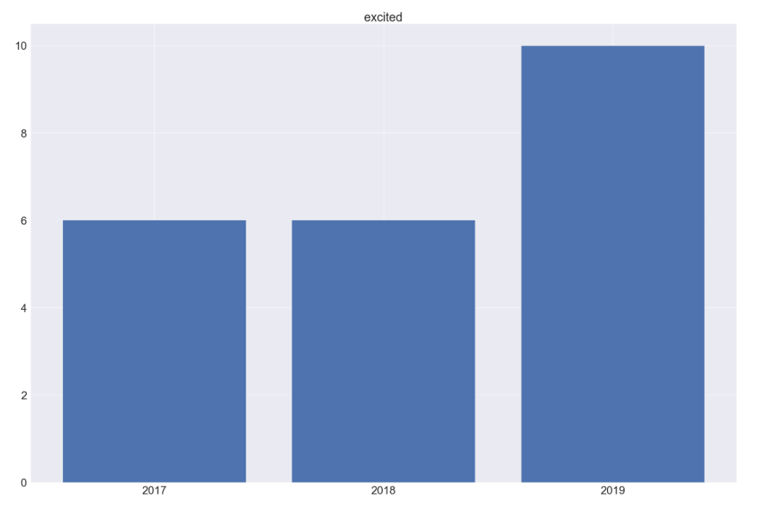
EXCITEMENT

Slide 10
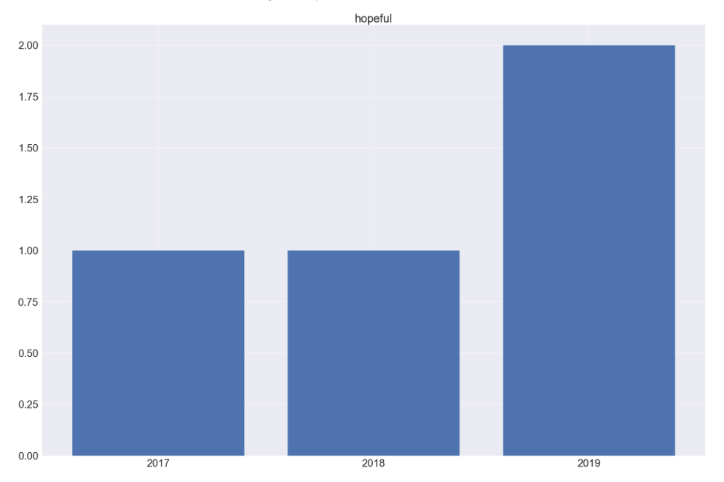
HOPE

Slide 11
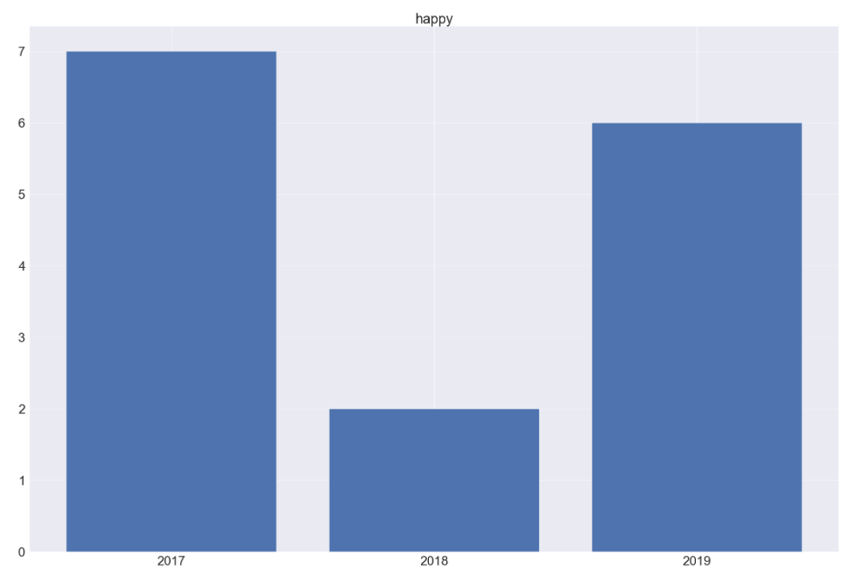
HAPPINESS

Slide 12
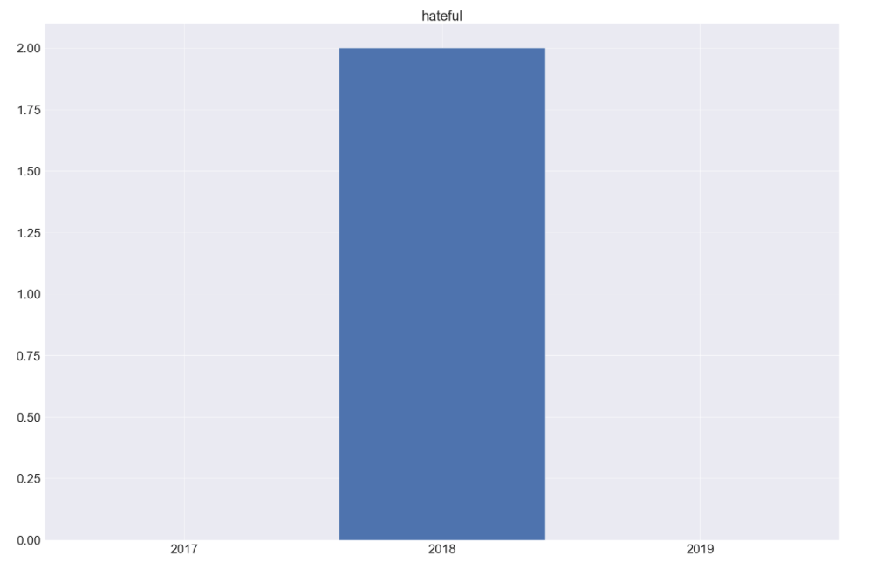
HATEFUL

Slide 13
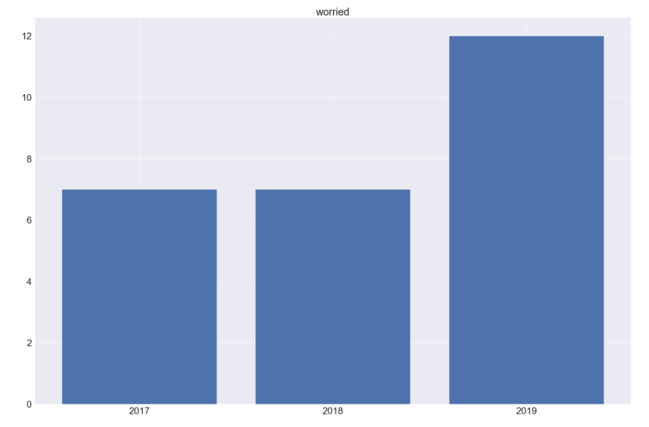
WORRY

Slide 14
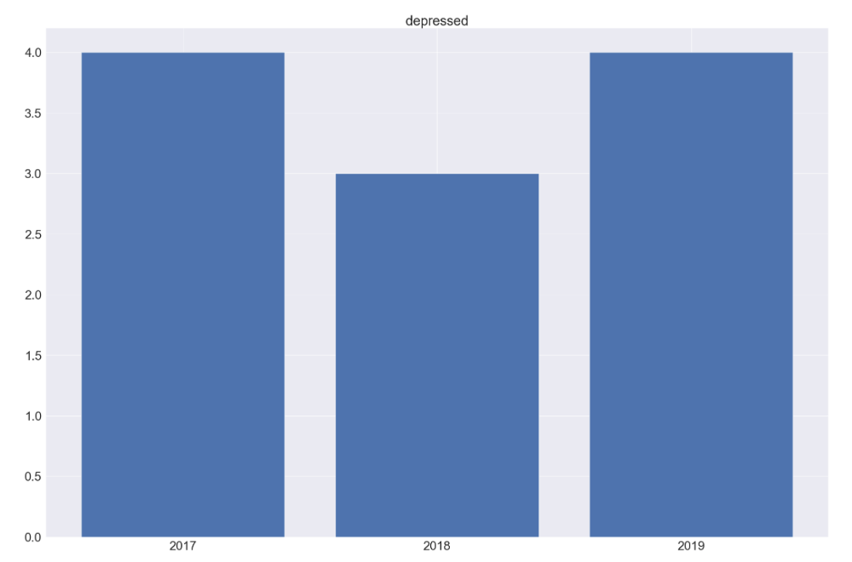
DEPRESSION

Slide 15
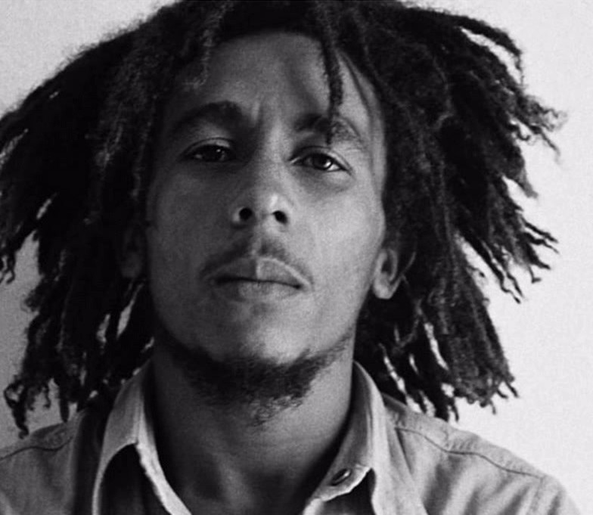
‘’’’ ONE GOOD THING ABOUT MUSIC WHEN IT HITS YOU, YOU FEEL NO PAIN’’’’
“” BOB MARLEY’’

Slide 16
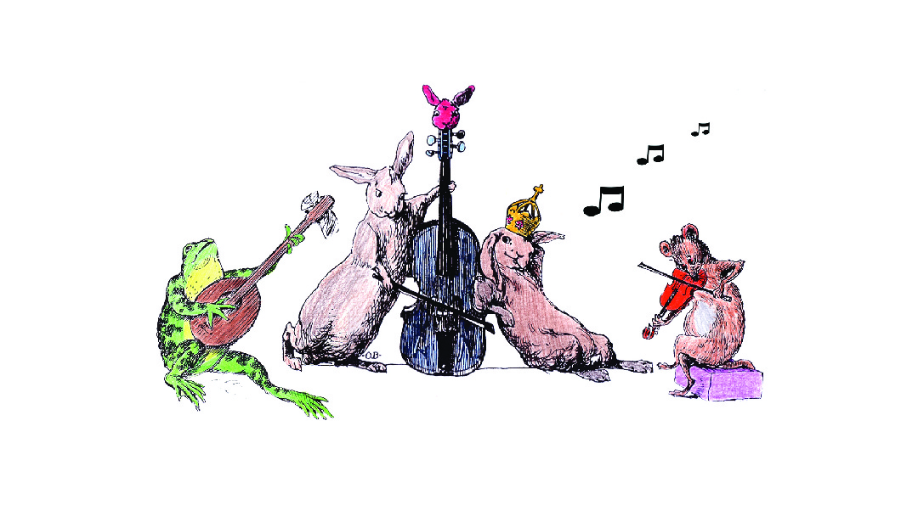
Any Questions ?!
Any questions?!

